Slide 1
thank you for downloading!
In case the embedded fonts don’t work, here are the download links:
Feather (Duolingo’s Font): https://www.cufonfonts.com/font/feather-2
Nunito:
https://fonts.google.com/specimen/Nunito

Slide 2
gen z lingo
by @dstoryco

Slide 3
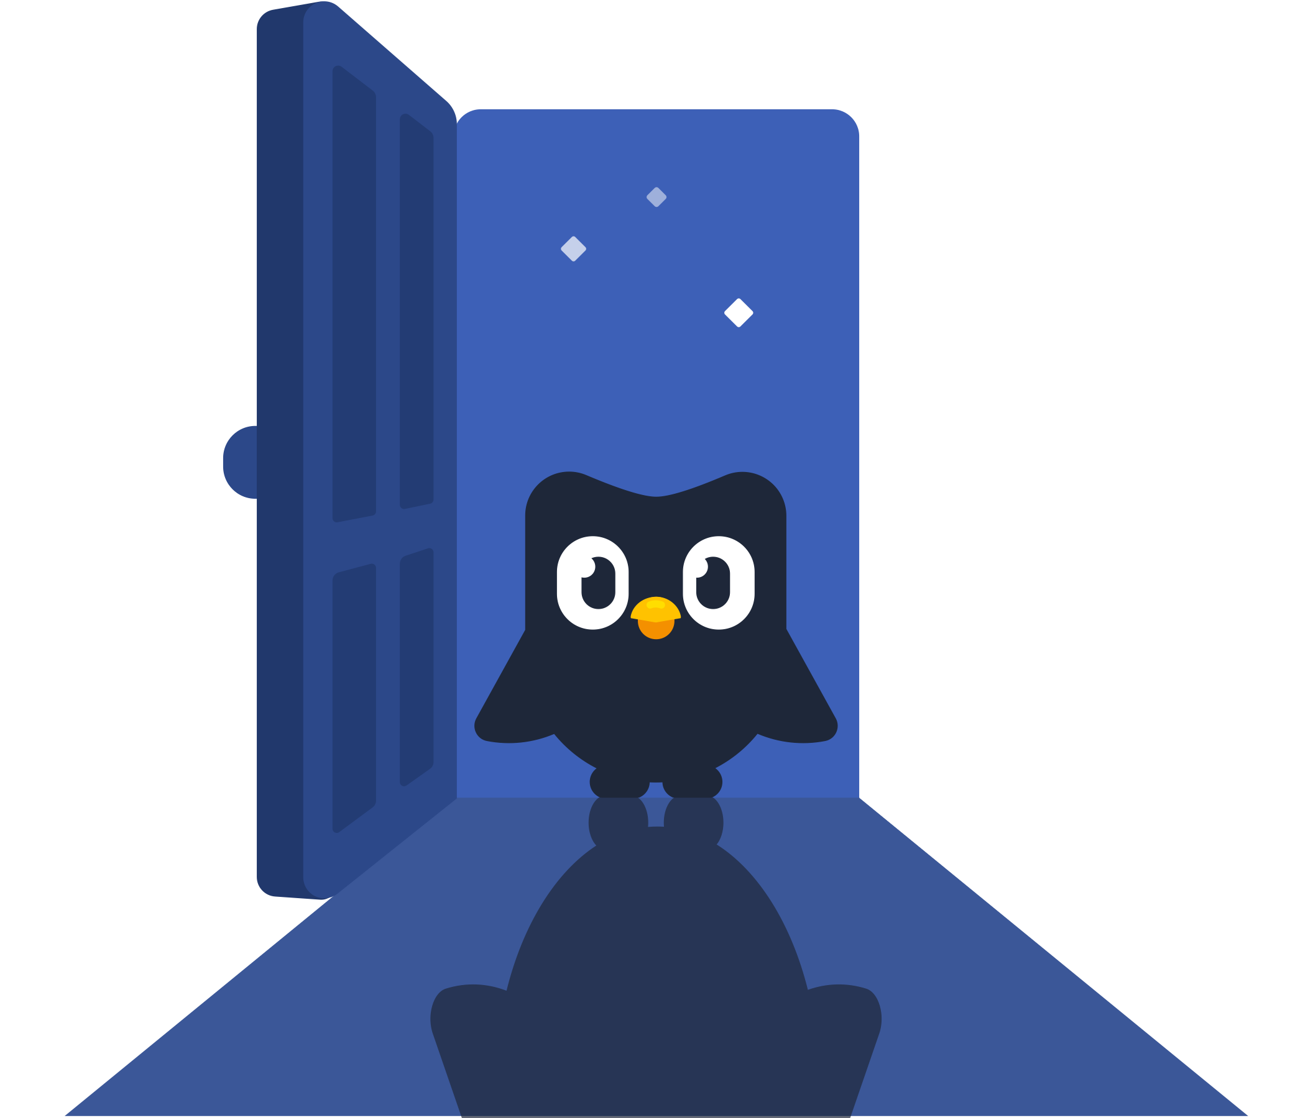
sneaky link
(n.) someone you’re seeing or hooking up with secretly

Slide 4
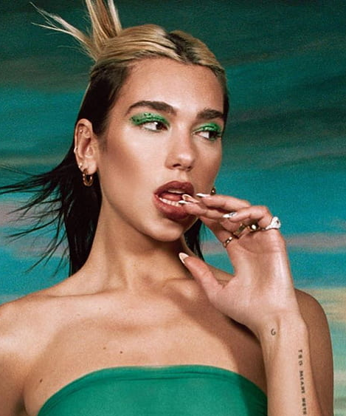


dua lipa
simp
(n.) a “try-hard”, or someone who goes way out of their way to do things for their crush or significant other.

Slide 5
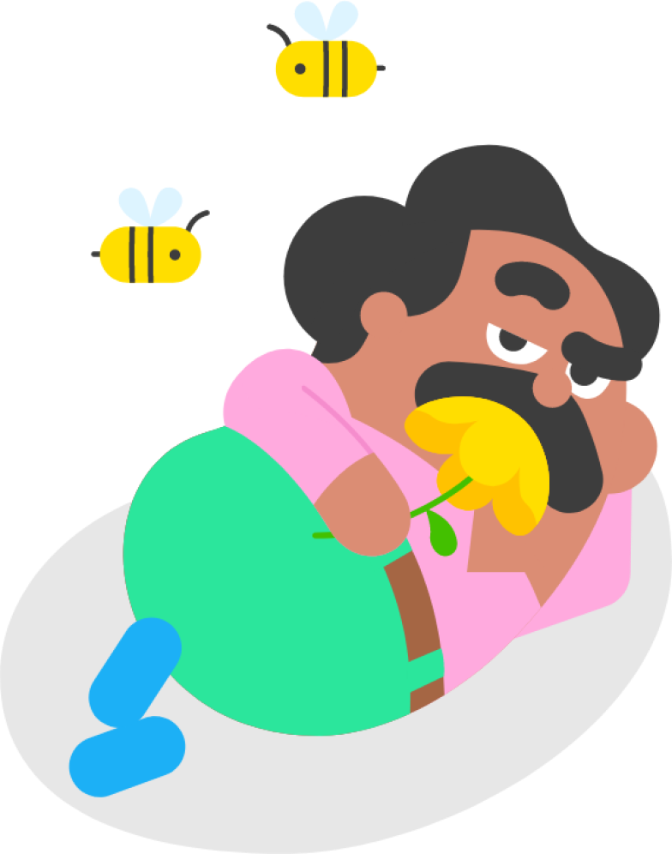

rizz
That body of yours is absurd
(n.) stems from “charisma”; skill in charming or seducing a potential romantic partner
5

Slide 6
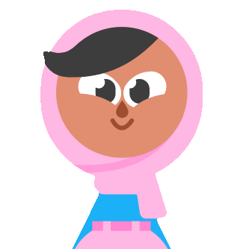
Did something well and understood what you were supposed to do
main
the
Understood
Stan
yikes
assignment
Bussin

Slide 7
Did something well and understood what you were supposed to do
Understood
main
the
Stan
yikes
assignment
Bussin

Slide 8
Did something well and understood what you were supposed to do
Understood
the
main
Stan
yikes
assignment
Bussin

Slide 9
Did something well and understood what you were supposed to do
Understood
the
assignment
main
Stan
yikes
Bussin

Slide 10
naur
“No” with an Australian accent. More dramatic way of saying "no".

Slide 11

Which one is the laughing emoji?
cowboy
skull
moon
manicure
🤠
💀
👽
💅

Slide 12
must-know canto

Slide 13


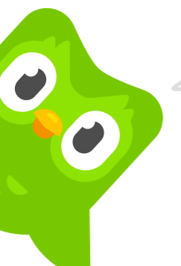
mm
goi
唔該
Please, excuse me or thank you

Slide 14

leng zai
nui
靚仔/女
Handsome boy / pretty girl

Slide 15
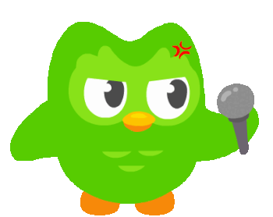
meh
wah
咩話
Whaaaaattt?!

Slide 16
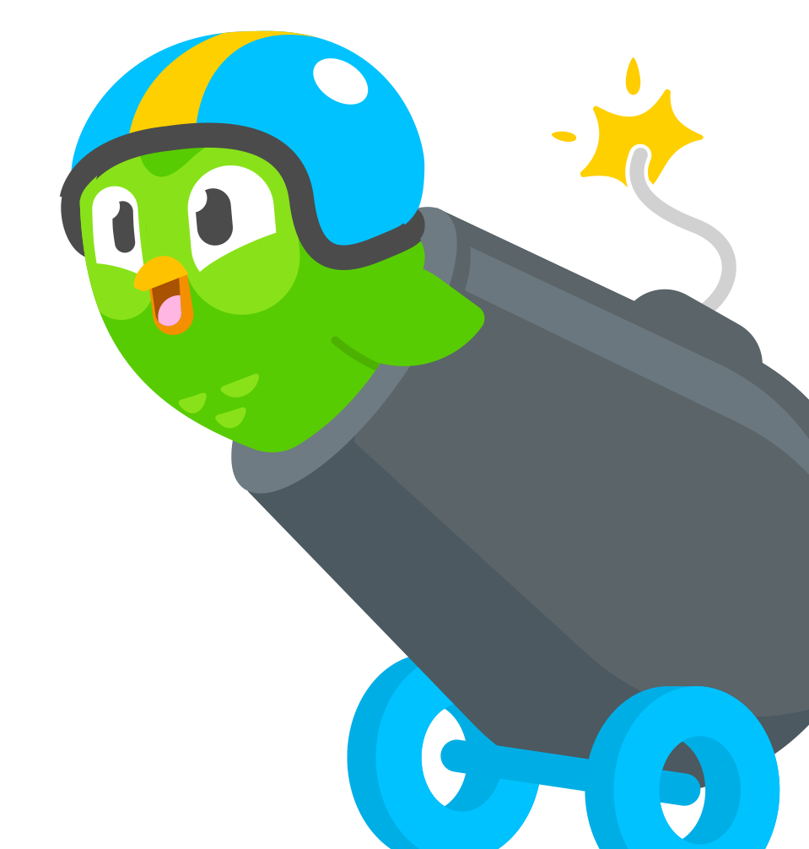
chi
sin
黐線
Crazy, ridiculous or idiotic

Slide 17
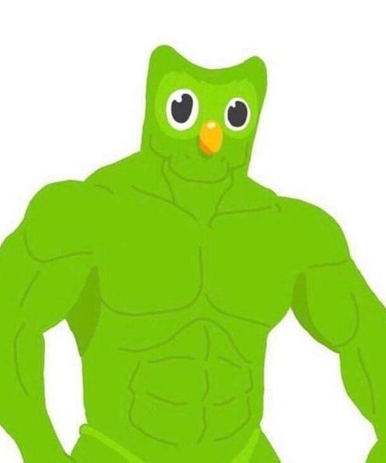
nei
wan
ye
ah
你玩野呀?
Are you kidding me?

Slide 18
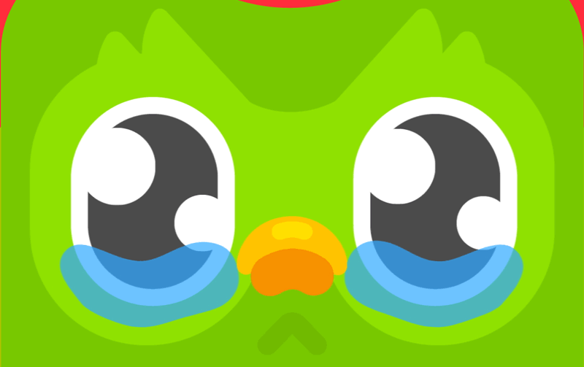
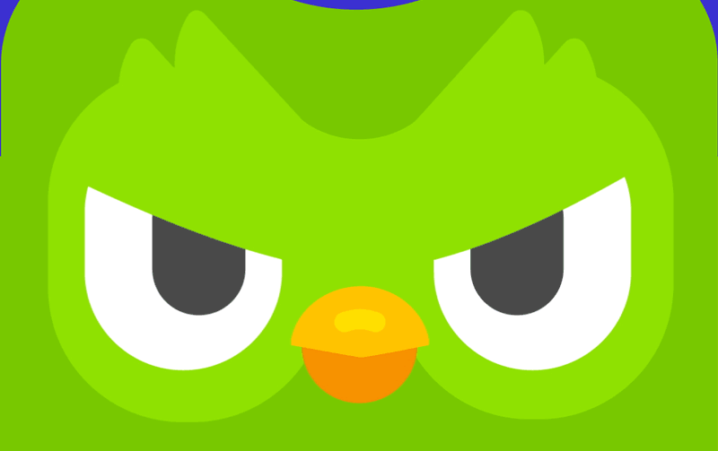
What she
What she actually
vs.
says
means

Slide 19
What does “shut uppp” mean?
be quiet
flirting
close door
🤫
🫦
🚪

Slide 20
It’s fine / I’m fine.
okay
not
flexing
It’s
fine
important
ignore

Slide 21
It’s fine / I’m fine.
It’s
okay
not
flexing
fine
important
ignore

Slide 22
It’s fine / I’m fine.
It’s
not
okay
flexing
fine
important
ignore

Slide 23
It’s fine / I’m fine.
It’s
not
fine
okay
flexing
important
ignore

Slide 24
You’re too nice to me.
We’re
considerate
compatible
Kind
hot
not
happy

Slide 25
You’re too nice to me.
We’re
considerate
compatible
Kind
hot
not
happy

Slide 26
You’re too nice to me.
We’re
not
considerate
compatible
Kind
hot
happy

Slide 27
You’re too nice to me.
We’re
not
compatible
considerate
Kind
hot
happy

